Slide 1
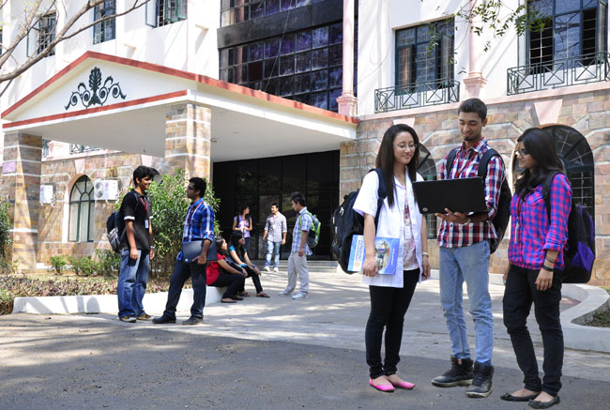

CSB4201 - DESIGN AND ANALYSIS AND ALGORITHMS
B.Tech – III Semester – Unit III
Mr. M. Sambath
Assistant professor
School of Computing Sciences,
Department of Computer Science and Engineering

Slide 2
Lecture 25 Topic : Greedy Algorithm

Slide 3
Greedy Technique
Constructs a solution to an optimization problem piece by
piece through a sequence of choices that are:
feasible, i.e. satisfying the constraints
locally optimal (with respect to some neighborhood definition)
greedy (in terms of some measure), and irrevocable
For some problems, it yields a globally optimal solution for every instance. For most, does not but can be useful for fast approximations. We are mostly interested in the former case in this class.
Defined by an objective function and a set of constraints

Slide 4
Applications of the Greedy Strategy
Optimal solutions:
change making for “normal” coin denominations
minimum spanning tree (MST)
single-source shortest paths
simple scheduling problems
Huffman codes
Approximations/heuristics:
traveling salesman problem (TSP)
knapsack problem
other combinatorial optimization problems

Slide 5
Change-Making Problem
Given unlimited amounts of coins of denominations d₁ > … > d_{m} ,
give change for amount n with the least number of coins
Example: d₁ = 25c, d₂ =10c, d₃ = 5c, d₄ = 1c and n = 48c
Greedy solution:
Greedy solution is
optimal for any amount and “normal’’ set of denominations
may not be optimal for arbitrary coin denominations
Q: What are the objective function and constraints?
<1, 2, 0, 3>
Ex: Prove the greedy algorithm is optimal for the above denominations.
For example, d1 = 25c, d2 = 10c, d3 = 1c, and n = 30c

Slide 6
Minimum Spanning Tree (MST)
Spanning tree of a connected graph G: a connected acyclic subgraph of G that includes all of G’s vertices
Minimum spanning tree of a weighted, connected graph G: a spanning tree of G of the minimum total weight
Example:
6
c
6
c
c
a
a
a
4
1
4
1
1
2
2
d
d
d
b
3
b
b
3

Slide 7
Prim’s MST algorithm
Start with tree T₁ consisting of one (any) vertex and “grow” tree one vertex at a time to produce MST through a series of expanding subtrees T₁, T₂, …, T_{n}
On each iteration, construct T_{i+1} from T_{i} by adding vertex not in T_{i} that is closest to those already in T_{i} (this is a “greedy” step!)
Stop when all vertices are included

Slide 8
Example
4
c
4
c
4
c
a
a
a
1
1
1
6
6
6
2
2
2
d
d
d
b
3
b
3
b
3
4
c
4
c
a
a
1
1
6
6
2
2
d
d
b
3
b
3

Slide 9
Another greedy algorithm for MST: Kruskal’s
Sort the edges in nondecreasing order of lengths
“Grow” tree one edge at a time to produce MST through a series of expanding forests F₁, F₂, …, F_{n-1}
On each iteration, add the next edge on the sorted list unless this would create a cycle. (If it would, skip the edge.)

Slide 10
Example
4
c
4
c
4
c
a
a
a
1
1
1
6
6
6
2
2
2
d
d
d
b
3
b
3
b
3
4
c
c
c
a
a
a
1
1
1
6
6
2
2
2
d
d
d
b
3
b
3
b
3

Slide 11
Notes about Kruskal’s algorithm
Algorithm looks easier than Prim’s but is harder to implement (checking for cycles!)
Cycle checking: a cycle is created if added edge connects vertices in the same connected component
Runs in O(m log m) time, with m = |E|. The time is mostly spent on sorting.

Slide 12
Lecture 26 Topic : Huffman Codes

Slide 13
Coding Problem
Coding: assignment of bit strings to alphabet characters
Codewords: bit strings assigned for characters of alphabet
Two types of codes:
fixed-length encoding (e.g., ASCII)
variable-length encoding (e,g., Morse code)
Prefix-free codes (or prefix-codes): no codeword is a prefix of another codeword
Problem: If frequencies of the character occurrences are
known, what is the best binary prefix-free code?
E.g. We can code {a,b,c,d} as {00,01,10,11} or {0,10,110,111} or {0,01,10,101}.
E.g. if P(a) = 0.4, P(b) = 0.3, P(c) = 0.2, P(d) = 0.1, then the average length of code #2 is 0.4 + 2*0.3 + 3*0.2 + 3*0.1 = 1.9 bits
It allows for efficient (online) decoding!
E.g. consider the encoded string (msg) 10010110…
The one with the shortest average code length. The average code length represents on the average how many bits are required to transmit or store a character.

Slide 14
Huffman codes
Any binary tree with edges labeled with 0’s and 1’s yields a prefix-free code of characters assigned to its leaves
Optimal binary tree minimizing the average
length of a codeword can be constructed
as follows:
Huffman’s algorithm
Initialize n one-node trees with alphabet characters and the tree weights with their frequencies.
Repeat the following step n-1 times: join two binary trees with smallest weights into one (as left and right subtrees) and make its weight equal the sum of the weights of the two trees.
Mark edges leading to left and right subtrees with 0’s and 1’s, respectively.
0
1
0
1
1
represents {00, 011, 1}

Slide 15
Example
character A B C D _
frequency 0.35 0.1 0.2 0.2 0.15
codeword 11 100 00 01 101
average bits per character: 2.25
for fixed-length encoding: 3
compression ratio: (3-2.25)/3*100% = 25%

Slide 16
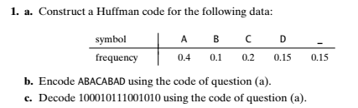
Activity

Slide 17
Lecture 27 Topic : Dynamic Programming

Slide 18
Dynamic Programming
Dynamic Programming is a general algorithm design technique
for solving problems defined by or formulated as recurrences with overlapping subinstances
Invented by American mathematician Richard Bellman in the 1950s to solve optimization problems and later assimilated by CS
“Programming” here means “planning”
Main idea:
set up a recurrence relating a solution to a larger instance to solutions of some smaller instances
- solve smaller instances once
record solutions in a table
extract solution to the initial instance from that table

Slide 19
Example: Fibonacci numbers
Recall definition of Fibonacci numbers:
F(n) = F(n-1) + F(n-2)
F(0) = 0
F(1) = 1
Computing the n^{th} Fibonacci number recursively (top-down):
F(n)
F(n-1) + F(n-2)
F(n-2) + F(n-3) F(n-3) + F(n-4)
...

Slide 20
Example: Fibonacci numbers (cont.)
Computing the n^{th} Fibonacci number using bottom-up iteration and recording results:
F(0) = 0
F(1) = 1
F(2) = 1+0 = 1
…
F(n-2) =
F(n-1) =
F(n) = F(n-1) + F(n-2)
Efficiency:
- time
- space
What if we solve it recursively?
n
n

Slide 21
Activity https://visualgo.net/en

Slide 22
Lecture 29 Topic: Matrix Chain Multiplication

Slide 23

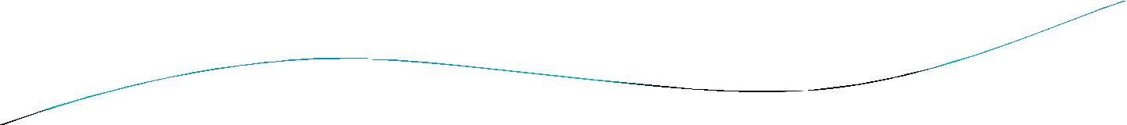


Matrix Chain Multiplication
Matrix multiplication is assosiative and so all
parenthesizations yield the same product.
For example, if the chain of matrices is ^{A}1^{A}2 ^{...A}4
A₁A₂ A₃ A₄
then the product can be fully
paranthesized in five distinct way:
(A₁(A₂(A₃A₄)))
(A₁((A₂A₃)A₄))
((A₁A₂)(A₃A₄))
((A₁(A₂A₃))A₄)
(((A₁A₂)A₃)A₄)

Slide 24

Matrix Multiply
MATRIX-MULTIPLY (A,B)
if columns [A] ≠ rows [B]
then error “incompatible dimensions”
else for i←1 to rows [A]
do for j←1 to columns [B]
do C[i, j]←0
for k←1 to columns [A]
do C[ i, j ]← C[ i, j] +A[ i, k]*B[ k, j]
return C

Slide 25

Example:
For example, we are going to multiply 4 matrices:
M₁ = 2 x 3
M₂ = 3 x 4
M₃ = 4 x 5
M₄ = 5 x 7
And we have conditions for multiplying matrices:
We can multiply only two matrices at a time.
When we go to multiply 2 matrices, the number of
₁st
columns of matrix should be same as the
number of rows of 2nd matrix.

Slide 26

We can multiply the chain of matrix by following those conditions in these ways:
M₁ | = 2 x 3 | ( M₁ M₂ )( M₃ M₄ ) | = 220
M₂ | = 3 x 4 | (( M₁ M₂ ) M₃ ) M₄ | = 134
M₃ | = 4 x 5 | M₁ ( M₂ ( M₃ M₄ ) | = 266
M₄ | = 5 x 7 | ( M₁ ( M₂ M₃ ) M₄ M₁ (( M₂ M₃ ) M₄ ) | = 160 = 207

Slide 27

The structure of an optimal paranthesization
Let A_{i...j} where i ≤ j, denote the matrix product
A_{i} A_{i+1} ... A_{j}
Any parenthesization of A_{i} A_{i+1} ... A_{j} must split the product between A_{k} and A_{k+1} for i ≤ k < j
Example: k = 4 (A₁A₂A₃A₄)(A₅A₆)
Total Cost of computing A[i,j] = minimum cost of A_{1..k}
and Cost of computing A_{k+1..j}
^{A}1..k * ^{A}k+1..j
+ Cost of multiplying

Slide 28

Algorithm to Optimal Cost
MATRIX-CHAIN-ORDER(p[ ], n)
for i ← 1 to n m[i, i] ← 0
for l ← 2 to n
for i ← 1 to n-l+1
j ← i+l-1
m[i, j] ← ∞
for k ← i to j-1
q ← m[i, k] + m[k+1, j] + p[i-1] p[k] p[j]
if q < m[i, j]
m[i, j] ← q
s[i, j] ← k
return m and s

Slide 29

matrix dimension
Example of Matrix Chain Multiplication
A₁ A₂ A₃ A₄ A₅ A₆
30 x 35
35 x 15
15 x 5
5 x 10
10 x 20
20 x 25
⎧m[2,2] + m[3,5] + p₁ p₂ p₅ = 0 + 2500 + 35 ⋅15 ⋅ 20 = 13000
⎪
m[2,5] = min ⎨m[2,3] + m[4,5] +p p p = 2625 + 100 + 35 ⋅ 5 ⋅ 20 = 7125
⎪
m[2,4] + m[5,5] + p p4 p = 4375 + 0 + 35 ⋅10 ⋅ 20 = 11375
⎩
1
5
= (7125)

Slide 30
Activity https://visualgo.net/en

Slide 31
Lecture 30 Topic : Optimal Binary Search Tree

Slide 32

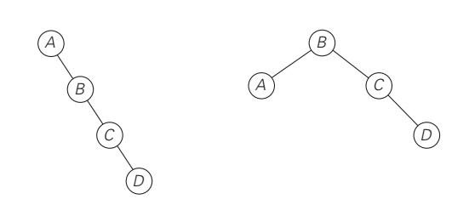
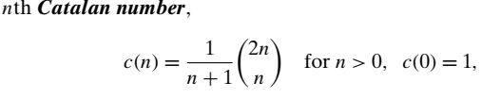
Optimal Binary Search Trees
Average # of comparisons =
1*0.1+ 0.2*2 + 0.4*3 + 0.3 *4 = 2.9
Average # of comparisons =
2*0.1+ 0.2*1 + 0.4*2 + 0.3 *3 = 2.1

Slide 33
Optimal Binary Search Trees
Problem: Given n keys a₁ < …< a_{n} and probabilities p₁, …, p_{n} searching for them, find a BST with a minimum average number of comparisons in successful search.
Since total number of BSTs with n nodes is given by C(2n,n)/(n+1), which grows exponentially, brute force is hopeless.
Example: What is an optimal BST for keys A, B, C, and D with search probabilities 0.1, 0.2, 0.4, and 0.3, respectively?
Average # of comparisons =
1*0.4 + 2*(0.2+0.3) + 3*0.1 = 1.7

Slide 34
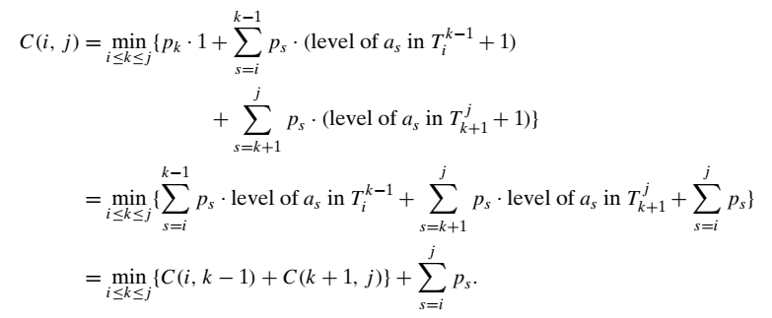
DP for Optimal BST Problem
Let C[i,j] be minimum average number of comparisons made in T[i,j], optimal BST for keys a_{i} < …< a_{j} , where 1 ≤ i ≤ j ≤ n. Consider optimal BST among all BSTs with some a_{k} (i ≤ k ≤ j ) as their root; T[i,j] is the best among them.

Slide 35

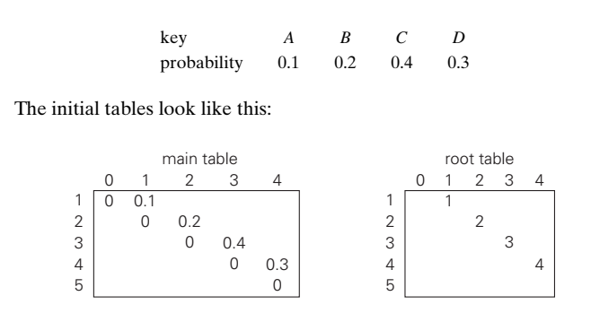
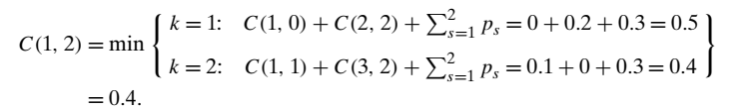
DP for Optimal BST Problem (cont.)

Slide 36
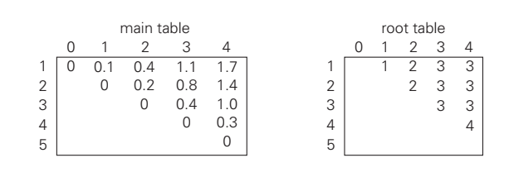
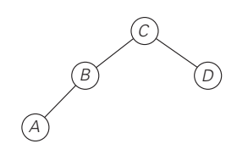
DP for Optimal BST Problem (cont.)
Average # of comparisons =
1*0.4 + 2*(0.2+0.3) + 3*0.1 = 1.7

Slide 37
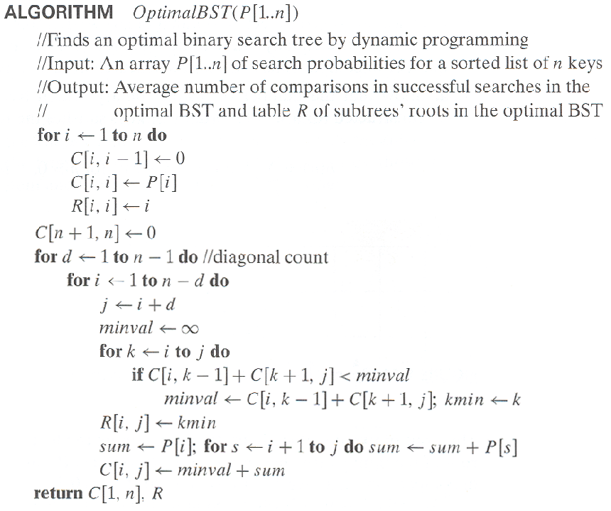
Optimal Binary Search Trees

Slide 38
Activity https://visualgo.net/en

